Slide 1

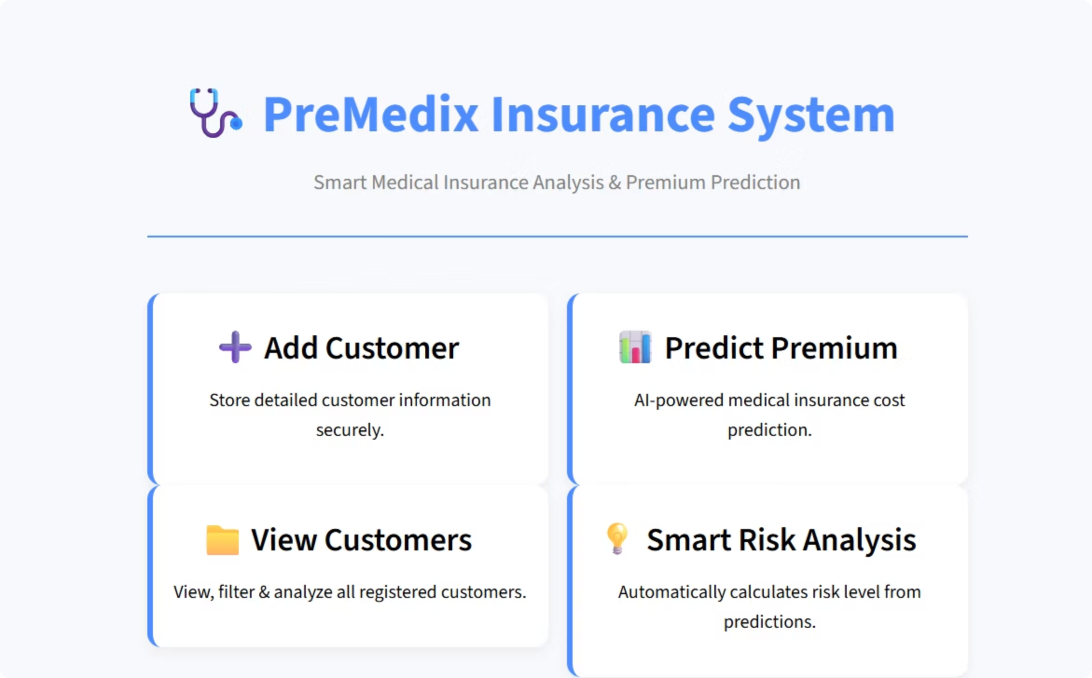
PreMedix – AI-Based Medical Insurance Prediction System
Smart Health Risk Analysis & Premium Prediction using Machine Learning
Presented By: Rosy
Reg id: 12200724
Supervised By: Dr. Ridhi Kapoor
Platform: Streamlit + Python + ML

Slide 2
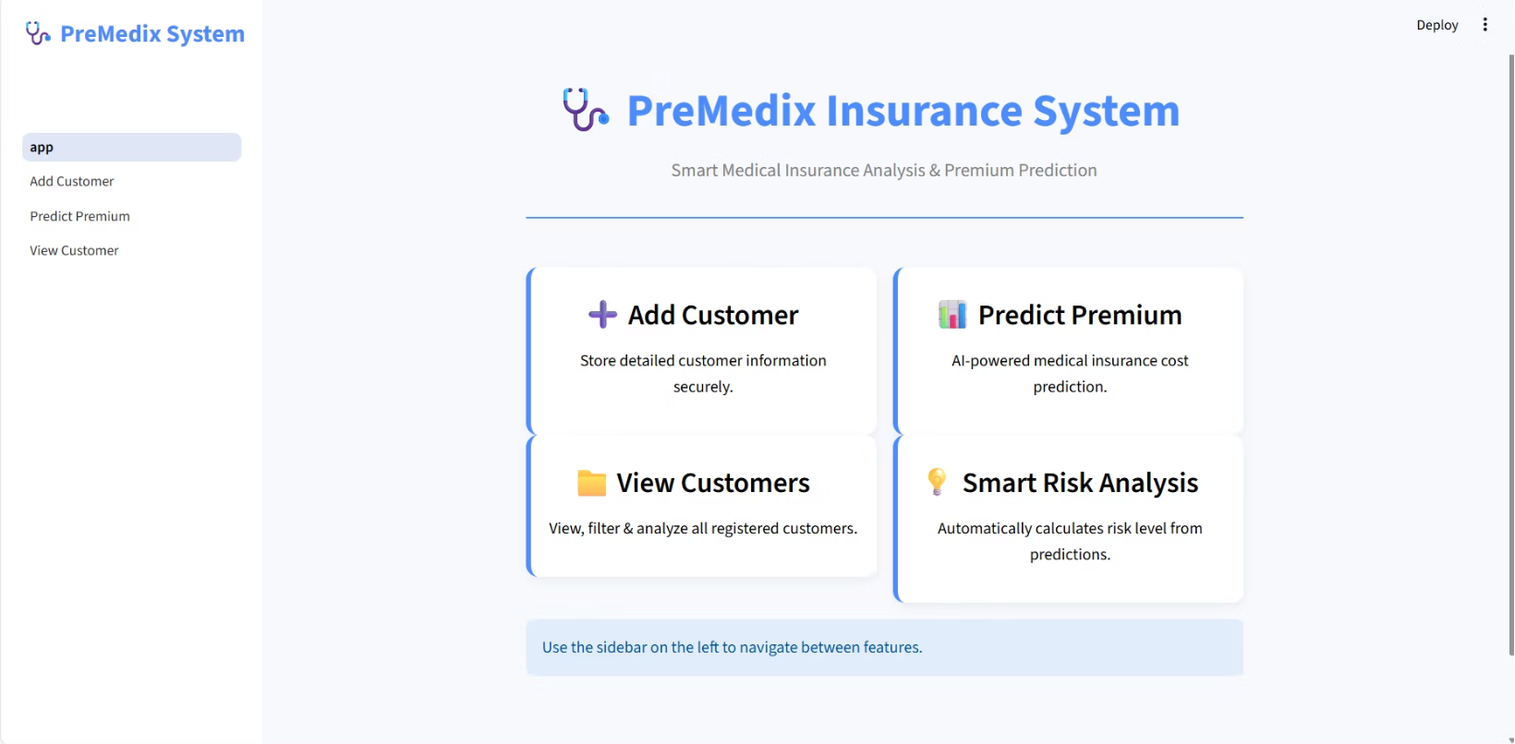
Introduction to PreMedix
PreMedix is an innovative web-based application designed to revolutionize medical insurance premium prediction through advanced machine learning.
Predicts medical insurance premiums using sophisticated ML algorithms.
Analyzes key health factors like BMI, age, and smoking status.
Securely stores customer data and performs real-time risk classification.
Developed with a powerful tech stack: Streamlit UI, Python, and a trained ML model.

Slide 3
Key Objectives of PreMedix
Our primary goals are to enhance efficiency and accuracy in medical insurance assessments, benefiting both providers and clients.
Automate Premium Calculation
Reduce Manual Errors
Fast & Accurate Risk Analysis
Minimize inaccuracies in premium calculations, leading to more reliable quotes.
Streamline the entire premium estimation process, moving away from manual calculations.
Provide immediate, data-driven insights into customer health risks.
Organized Customer Database
User-Friendly Application
Deliver an intuitive and simple interface for real-world insurance scenarios.
Maintain a centralized, easy-to-access repository of health profiles.

Slide 4





Technology Stack Powering PreMedix
PreMedix leverages a robust set of modern technologies to ensure reliability, scalability, and an intuitive user experience.
Python
Streamlit
ML Model (Pickle)
The core programming language for backend logic and ML operations.
Used for rapidly building and deploying the interactive web-based user interface.
Pre-trained regression model for accurate premium predictions, stored in a .pkl file.
Pandas & CSV
HTML/CSS
Efficiently handles dataset management and customer data storage.
Custom styling and visualization enhancements within the Streamlit application.

Slide 5






PreMedix System Workflow
A seamless flow from user input to premium prediction and data management.
Fetch by Phone
ML Prediction
View Customers
Enter Details
Save CSV

Slide 6
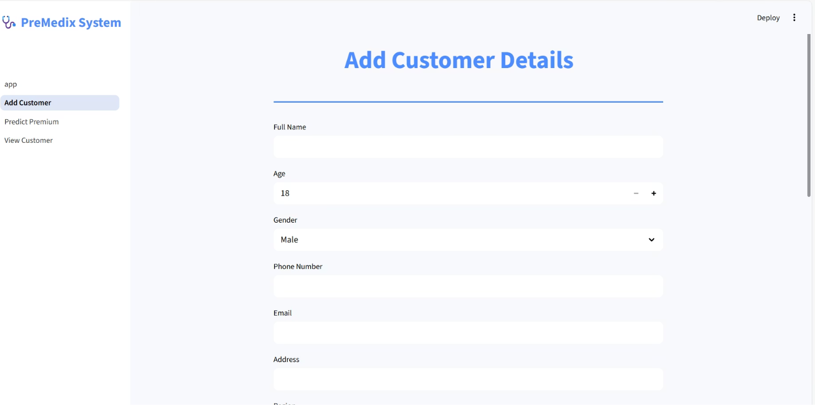
Add Customer Module: Comprehensive Data Capture
The "Add Customer" module ensures all relevant client information is securely recorded for accurate analysis.
Personal Information: Name, Age, Gender, Phone, Email, Address.
Health Information: BMI, Diabetes status, Smoker status, Alcohol consumption.
Lifestyle Details: Exercise level, Blood Pressure readings.
Geographical Data: Region of residence.
All data is appended to a customers.csv file with a timestamp.
Features a clean form UI with robust validation for data integrity.

Slide 7









Predict Premium Module: Instant Insights
Unlock rapid and precise insurance premium estimations and risk assessment.
Fetch Customer
ML Prediction
Display Premium
Enter a phone number to retrieve existing customer data.
Model uses Age, BMI, Children, and Smoker status to predict premium.
Predicted premium shown in ₹ with clear formatting.
Medium Risk
< ₹20,000
Low Risk
< ₹10,000
High Risk
> ₹20,000
An option to Save Prediction allows updating the database with the new premium and risk level.

Slide 8
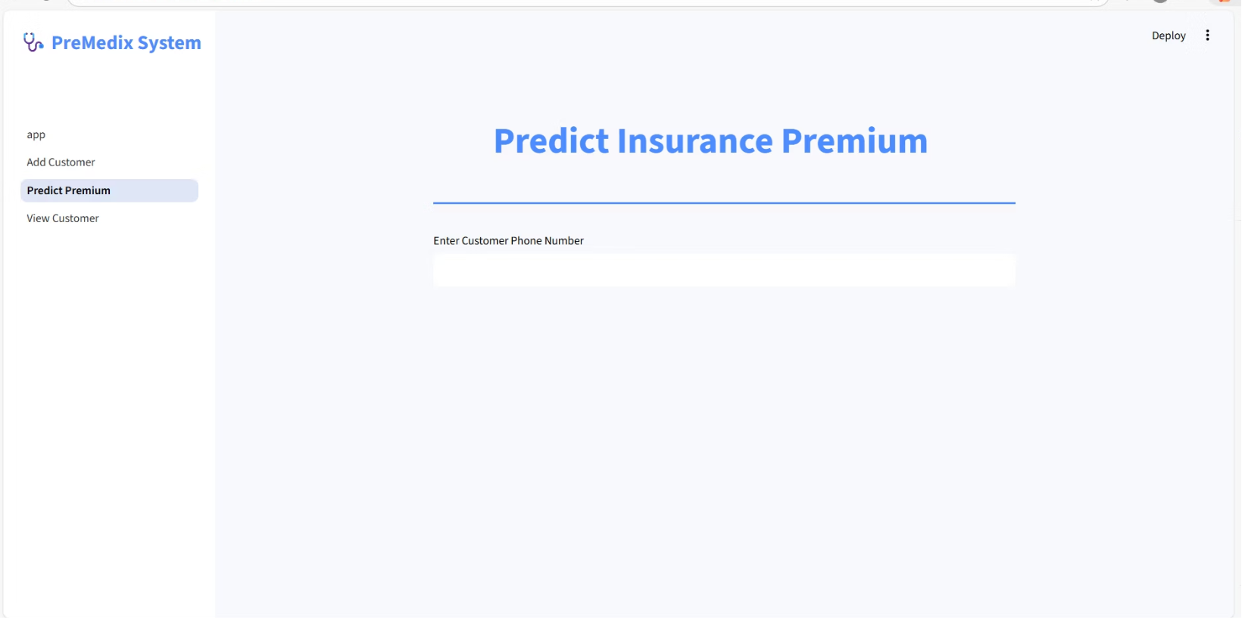
The Core: Machine Learning Model
Our AI-powered regression model is the heart of PreMedix, ensuring highly accurate and consistent premium predictions.
Training Data: Model meticulously trained on a comprehensive insurance dataset.
Key Features: Utilizes Age, BMI, Number of Children, and Smoker Status as primary predictors.
Model Persistence: Stored as a pickle file (insurancemodelf.pkl) for efficient loading.
Performance: Delivers exceptionally accurate and consistent premium predictions every time.

Slide 9
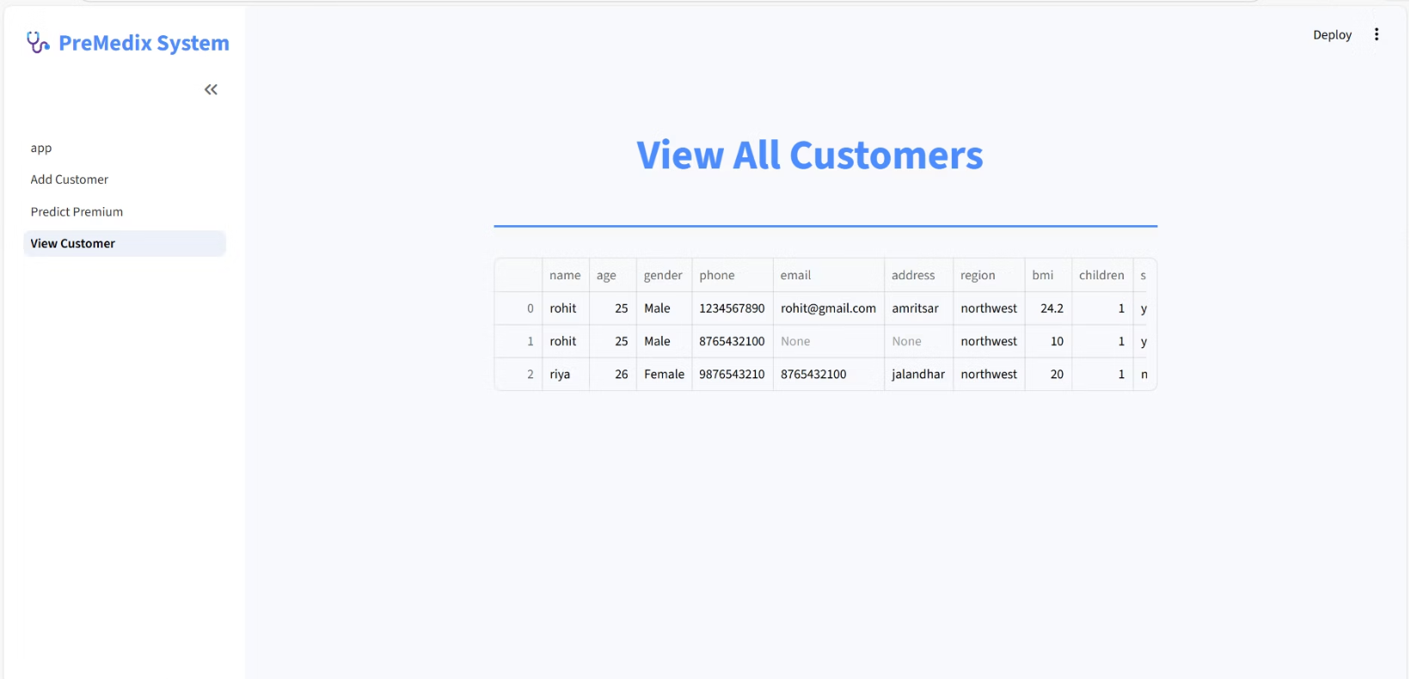
View Customers Module: Comprehensive Data Overview
Effortlessly access and analyze all stored customer records, predictions, and risk levels in one organized view.
Full Database Display: Presents all customer information in a clear, tabular format.
Detailed Records: Includes saved customer details, predicted premiums, and assigned risk levels.
Analytical Tool: Facilitates easy tracking and analysis of all stored records.
Data Integrity: Ensures all vital information is readily available for review and decision-making.

Slide 10




Conclusion: PreMedix – The Future of Insurance Prediction
PreMedix offers a complete, AI-driven solution that streamlines insurance processes and enhances efficiency across the board.
1
AI in Healthcare
2
Improved Workflow
3
Secure Records
4
Accurate Premiums
Provides accurate premium prediction through sophisticated ML.
Securely stores customer records for reliable data management.
Improves workflow efficiency for insurance agents and healthcare providers.
A clear demonstration of practical AI implementation in the healthcare sector.

